Slide 1
COMP 2000
Week 10 - Monday

Slide 2
Last time
What did we talk about last time?
Reading and writing binary files
Serialization

Slide 3
Questions?

Slide 4
Project 3

Slide 5
Reading and Writing Whole Objects

Slide 6
What if I wanted to read or write a whole object?
An object has data inside of it
Each piece of data is either a reference to an object or is primitive data
When reading or writing whole objects, we could read or write each piece of data separately
But doing so is challenging because we could forget some data
And because there could be circular references:
Object A might have a reference to object B which might have a reference to object A again…

Slide 7
Serialization
Serialization takes a reference to an object and dumps it into a file
It writes representations to primitive types pretty much the same way that a DataOutputStream does
And if there're objects inside of the object you're serializing, it serializes them too
And! Serialization makes a note of all the objects that are getting serialized, so if it sees an object a second time, it just writes down a serial number for it instead of the whole thing

Slide 8
Example Serializable class
Here's a class we might want to be able to dump into a file
public class Troll implements Serializable {
private String name;
private int age;
private Object hatedThing; // All trolls hate something
public Troll(String name, int age, Object hatedThing) {
this.name = name;
this.age = age;
this.hatedThing = hatedThing;
}
public Object getHatedThing() {
return hatedThing;
}
}

Slide 9
Example of writing
Here's some code that creates a couple of Troll objects and then writes them to a file called trolls.dat
Troll tom = new Troll("Tom", 351, "Bilbo Baggins");
Troll bert = new Troll("Bert", 417, tom);
ObjectOutputStream out = null;
try {
out = new ObjectOutputStream(new FileOutputStream("trolls.dat"));
out.writeObject(tom);
out.writeObject(bert);
}
catch(IOException e) {
System.out.println("Serialization failed.");
}
finally { try{ out.close(); } catch(Exception e){} }

Slide 10
Example of reading
Here's some code that reads in the Troll objects we serialized in the previous example
Troll tom = null;
Troll bert = null;
ObjectInputStream in = null;
try {
in = new ObjectInputStream(new FileInputStream("trolls.dat"));
tom = (Troll)in.readObject();
bert = (Troll)in.readObject();
}
catch(IOException e) {
System.out.println("Deserialization failed.");
}
finally { try{ in.close(); } catch(Exception e){} }

Slide 11
The good
Serialization allows you to read or write objects (even complex objects) or arrays of objects in a single line of code
It's an impressive achievement of Java
To make your own classes serializable, all you have to do is mark them with the Serializable interface
An interface with no methods!
It more or less works like magic!

Slide 12
The bad
Some objects are not serializable, but they are comparatively rare
An example is the Thread class, which encapsulates the state of a currently running thread…so how could you store it on disk?
Serialization does have storage overhead needed to keep track of the size of arrays and type information about classes
You might be able to use less space if you stored the data directly

Slide 13
The ugly
If you forget to mark one of your classes Serializable, it will crash your code when you try to write it out, even indirectly
If you serialize objects to a file but later change the class, adding or removing members or methods, you will no longer be able to read those objects back from the file
Their data in the file will no longer match what the class is supposed to look like
This problem can happen with different versions of the same program

Slide 14
Internet

Slide 15
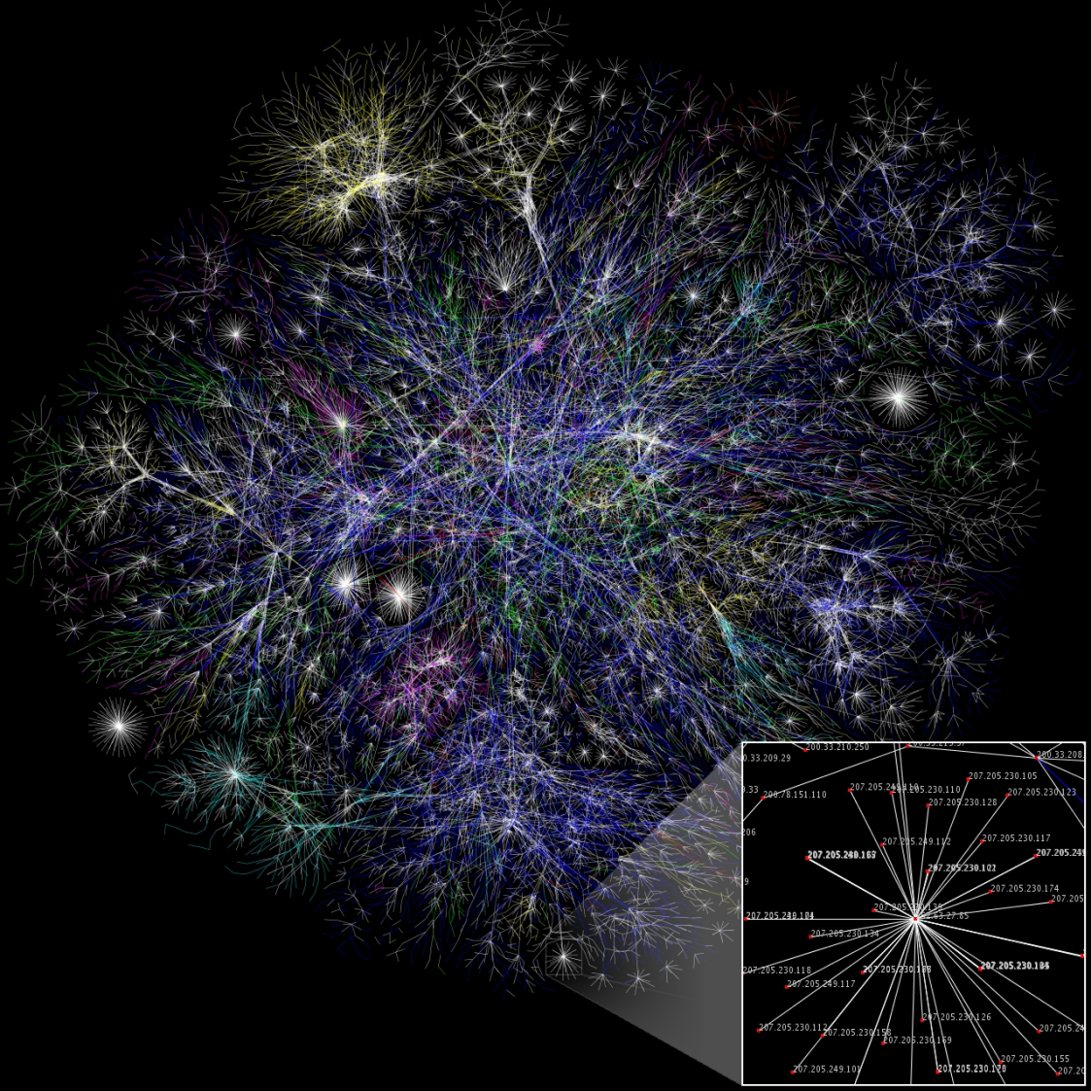

Slide 16
What is the Internet?
The network of hardware and software systems that connects many of the world's computers
Typically, people say the Internet and capitalize the "I" because there is only one
Until we meet aliens
Or decide to break off from the rest of the world
The World Wide Web is the part of the Internet that is concerned with webpages
The Internet also includes:
FTP
VOIP
Bittorrent
Multiplayer video games
Much, much more…

Slide 17
Packet switched
The Internet is a packet switched system
Individual pieces of data (called packets) are sent on the network
Each packet knows where it is going
A collection of packets going from point A to point B might not all travel the same route
C
1
B
A
2
D

Slide 18
Circuit switched
Traditionally, phone lines have been circuit switched
A specific circuit is set up for a specific communication
Operators used to do this by hand
Now it is done automatically
Only one path for data
A
C
B
1

Slide 19
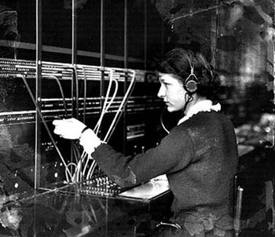
Circuit vs. packet switching
Which one is faster?
Circuit switching
Which one is more predictable?
Circuit switching
So, why is the Internet packet switched?
More adaptable

Slide 20
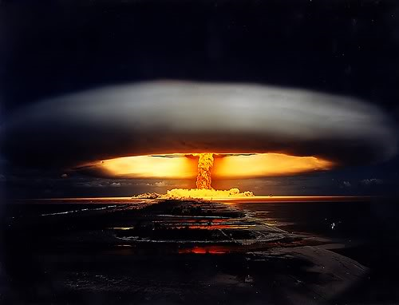
Birth of the Internet
The Advanced Research Projects Agency was created in 1958 to respond to the Russians launching Sputnik
The ARPANET connected its first two major nodes over 10 years later
Packet switching was used so that the network could still communicate after a nuclear strike

Slide 21
IP addresses
Computers on the Internet have addresses, not names
Google.com is actually [74.125.67.100]
Google.com is called a domain
The Domain Name System or DNS turns the name into an address

Slide 22
IPv4
Old-style IP addresses are in this form:
74.125.67.100
4 numbers between 0 and 255, separated by dots
That's a total of 256⁴ = 4,294,967,296 addresses
But there are 7 billion people on earth…

Slide 23
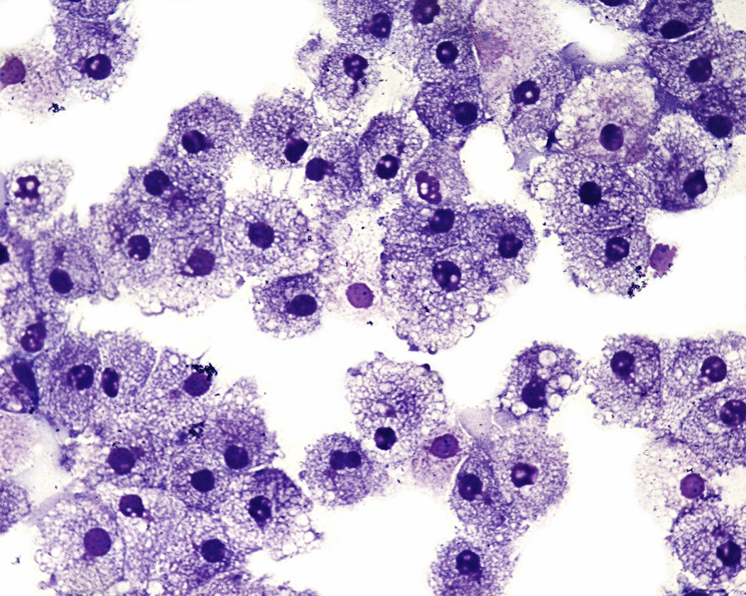
IPv6
IPv6 are the new IP addresses that are beginning to be used by modern hardware
8 groups of 4 hexadecimal digits each
2001:0db8:85a3:0000:0000:8a2e:0370:7334
1 hexadecimal digit has 16 possibilities
How many different addresses is this?
16³² = 2¹²⁸ ≈ 3.4×10³⁸ is enough to have 500 trillion addresses for every cell of every person's body on Earth
Will it be enough?!

Slide 24
Other failures in design
Y2K bug
2 bytes for the date is not enough
It's all just going to get messed up in Y10K
Y2038 bug
Unix and Linux machines often use a signed 32-bit integer to represent seconds since January 1, 1970
Zip codes
Vehicle identification numbers

Slide 25
Networking

Slide 26
OSI seven layer model
You can build layers of I/O on top of other layers
System.out.println() is built on top of low-level calls, eventually some C system call to the OS
One standard networking model is called the Open Systems Interconnection Reference Model
Also called the OSI model
Or the 7 layer model

Slide 27
Protocols
Application
Transport
Physical
Presentation
Session
Network
Data Link
There are many different communication protocols
The OSI reference model is an idealized model of how different parts of communication can be abstracted into 7 layers
Imagine that each layer is talking to another parallel layer called a peer on another computer
Only the physical layer is a real connection between the two

Slide 28
Layers
Not every layer is always used
Sometimes user errors are referred to as Layer 8 problems
Layer | Name | Mnemonic | Activity | Example
7 | Application | Away | User-level data | HTTP
6 | Presentation | Pretzels | Data appearance, some encryption | SSL
5 | Session | Salty | Sessions, sequencing, recovery | IPC and part of TCP
4 | Transport | Throw | Flow control, end-to-end error detection | TCP
3 | Network | Not | Routing, blocking into packets | IP
2 | Data Link | Dare | Data delivery, packets into frames, transmission error recovery | Ethernet
1 | Physical | Programmers | Physical communication, bit transmission | Electrons in copper

Slide 29
Physical layer
There is where the rubber meets the road
The actual protocols for exchanging bits as electronic signals happen at the physical layer
At this level are things like RJ45 jacks and rules for interpreting voltages sent over copper
Or light pulses over fiber

Slide 30
Data link layer
Ethernet is the most widely used example of the data layer
Machines at this layer are identified by a 48-bit Media Access Control (MAC) address
The Address Resolution Protocol (ARP) can be used for one machine to ask another for its MAC address
Some routers allow a MAC address to be spoofed, but MAC addresses are intended to be unique and unchanging for a particular piece of hardware

Slide 31
Network layer
The most common network layer protocol is Internet Protocol (IP)
Each computer connected to the Internet should have a unique IP address
IPv4 is 32 bits written as four numbers from 0 – 255, separated by dots
IPv6 is 128 bits written as 8 groups of 4 hexadecimal digits
We can use tracert on Windows to see the path of hosts leading to some IP address

Slide 32
Transport layer
There are two popular possibilities for the transport layer
Transmission Control Protocol (TCP) provides reliability
Sequence numbers for out of order packets
Retransmission for packets that never arrive
User Datagram Protocol (UDP) is simpler
Packets can arrive out of order or never show up
Many online games use UDP because speed is more important

Slide 33
Session layer
This layer doesn't necessarily exist in the TCP/IP model
Transport Layer Security (TLS) uses the session layer
TLS is the end-to-end encryption that HTTPS uses
You know you're using TLS if there's a little lock showing on your browser
Google is pushing for all websites to be HTTPS
HTTPS is safer, but there's some overhead for the encryption, and websites have to have certificates for their public keys

Slide 34
Presentation layer
The presentation layer is often optional
It specifies how the data should appear
This layer is responsible for character encoding (ASCII, UTF-8, etc.)
MIME types are sometimes considered presentation layer issues

Slide 35
Application layer
This is where the data is interpreted and used
HTTP is an example of an application layer protocol
A web browser takes the information delivered via HTTP and renders it
Code you write deals significantly with the application layer

Slide 36
Transparency
The goal of the OSI model is to make lower layers transparent to upper ones
Application
Presentation
Session
Transport
Network
Data Link
Physical
Payload
Application
Presentation
Session
Transport
Network
Data Link
Physical
Payload
Payload
UDP | Payload
IP | UDP | Payload
MAC | IP | UDP | Payload

Slide 37
Mnemonics
Seven layers is a lot to remember
Mnemonics have been developed to help
Application | All | All | A | Away
Presentation | Pros | People | Powered-Down | Pretzels
Session | Search | Seem | System | Salty
Transport | Top | To | Transmits | Throw
Network | Notch | Need | No | Not
Data Link | Donut | Data | Data | Dare
Physical | Places | Processing | Packets | Programmers

Slide 38
TCP/IP
The OSI model is sort of a sham
It was invented after the Internet was already in use
You don't need all layers
Some people think this categorization is not useful
Most network communication uses TCP/IP
We can view TCP/IP as four layers:
Layer | Action | Responsibilities | Protocol
Application | Prepare messages | User interaction | HTTP, FTP, etc.
Transport | Convert messages to packets | Sequencing, reliability, error correction | TCP or UDP
Internet | Convert packets to datagrams | Flow control, routing | IP
Physical | Transmit datagrams as bits | Data communication

Slide 39
TCP/IP
A TCP/IP connection between two hosts (computers) is defined by four things
Source IP
Source port
Destination IP
Destination port
One machine can be connected to many other machines, but the port numbers keep the different connections straight

Slide 40
Common port numbers
Certain kinds of network communication are usually done on specific ports
20 and 21: File Transfer Protocol (FTP)
22: Secure Shell (SSH)
23: Telnet
25: Simple Mail Transfer Protocol (SMTP)
53: Domain Name System (DNS) service
80: Hypertext Transfer Protocol (HTTP)
110: Post Office Protocol (POP3)
443: HTTP Secure (HTTPS)

Slide 41
Upcoming

Slide 42
Next time…
Socket communication

Slide 43
Reminders
Work on Project 3
Project 3 is now due on April 3
Keep reading Chapter 21

